Slide 1

UNIVERSITY OF RWANDA
COLLEGE OF SCIENCE AND TECHNOLOGY
Y3 CSE
Group 4: TransConnect
  Members: MUSAZA PATRICK (223019061)
  MANZI NSENGA IVAN (223004392)
Module: Computing Intelligence & Applications
Date: 28th October 2025
#3

Slide 2



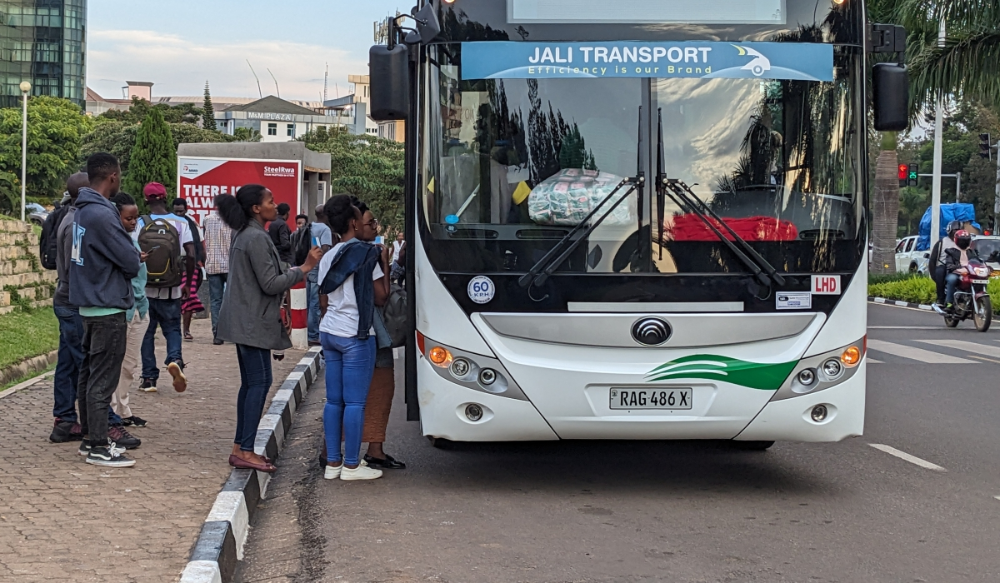





DATASET OVERVIEW
Data Description:
Tabular data with bus routes, stop names, and coordinates
Source: Bus route information for Kigali public transport
Multiple routes with sequential stops
Mixed data types: text (stop names) and numeric (coordinates
Initial Data Quality Issues:
Inconsistent stop naming conventions
Mixed coordinate formats S139282 E30.28382)
Potential missing values and duplicates
Non-standardized data structure across routes
Nature: Spatial-Temporal Data with Geographic Coordinates

Slide 3
1. DATA CLEANING
Purpose: Handle missing, incorrect, and inconsistent data
# Load the route details CSV file
df = pd.read_csv('Route Details - Kabuga - Nyabugogo.csv’)
# Clean coordinate formats - convert S/E to negative/positive
df_clean['latitude'] = df_clean['Latitude'].str.replace('S', '-').astype(float)
df_clean['longitude'] = df_clean['Longitude'].str.replace('E', '').astype(float)
# Handle missing values
df_clean = df_clean.dropna(subset=['latitude', 'longitude', 'Stops'])
# Remove duplicates based on stop name and coordinates
df_clean = df_clean.drop_duplicates(subset=['Stops', 'latitude', 'longitude'])
Application to TransConnect:
Identify missing values
Clean coordinate formats: Remove ‘E’, ‘S’ characters
Convert to standard decimal degrees: -1.39282, 30.28382
Handle missing stop names or coordinates
Handle duplicates

Slide 4
2. DATA INTEGRATION
Data Integration:
Merge multiple route datasets into unified structure
Create stops table (unique stops with IDs)
Create routes table (route sequences referencing stops)
Impact:
Efficient multi-route management
# Create unique stop IDs
df_clean['stop_id'] = range(1, len(df_clean) + 1)
# Assign route information
df_clean['route_id'] = 'Kabuga_Nyabugogo_001'
df_clean['route_name'] = 'Kabuga - Nyabugogo'
# Create route-stop sequence mapping
route_stop_sequence = {
'Kabuga_Nyabugogo_001': df_clean[['stop_id', 'stop_sequence', 'Stops']].sort_values('stop_sequence').to_dict('records')
}

Slide 5
3. DATA REDUCTION
Data Reduction:
Remove irrelevant columns: "Route Price"
Focus on core features: stop_id, latitude, longitude
Deduplicate identical stops across routes
# Select key features for modeling
essential_features = [
'route_id', 'route_name', 'stop_id', 'stop_sequence',
'latitude', 'longitude', 'Stops'
]
df_reduced = df_integrated[essential_features].copy()
# Rename columns for consistency
df_reduced = df_reduced.rename(columns={'Stops': 'stop_name'})
# Remove irrelevant columns that were in raw data
columns_removed = set(df_integrated.columns) - set(essential_features)
Impact:
Faster processing for route optimization
Foundation for transfer point identification

Slide 6


R = 6371 # Earth radius in km
# Convert degrees to radians
lat1, lon1, lat2, lon2 = map(radians, [lat1, lon1, lat2, lon2])
dlat = lat2 - lat1
dlon = lon2 - lon1
# Haversine formula
a = sin(dlat/2)**2 + cos(lat1) * cos(lat2) * sin(dlon/2)**2
c = 2 * atan2(sqrt(a), sqrt(1-a))
4. DATA TRANSFORMATION
Purpose: Convert data into model-ready format
Key Transformations for TransConnect:
Coordinate validation and normalization
Feature engineering using Haversine formula:
Distance between consecutive stops
Estimated travel time between stops
Create sequential ordering of stops
# Update distance to next stop
df_reduced.loc[current_idx, 'distance_to_next'] = distance
# Estimate travel time (assuming average speed 25 km/h in urban areas)
travel_time = (distance / 25) * 60 # Convert to minutes
df_reduced.loc[current_idx, 'estimated_travel_time_min'] = travel_time
Impact::
Raw coordinates actionable features for AI model

Slide 7
5. DATA DISCRETIZATION
Data Discretization:
Purpose: Convert continuous data into categories for simpler analysis.
# Discretize cumulative distance into route segments
max_distance = df_transformed['cumulative_distance'].max()
distance_bins = [0, max_distance*0.25, max_distance*0.5, max_distance*0.75, max_distance + 0.1]
distance_labels = ['Start', 'Early', 'Mid', 'Late']
df_transformed['route_segment'] = pd.cut(
df_transformed['cumulative_distance'],
bins=distance_bins,
labels=distance_labels,
include_lowest=True
)
Convert continuous "distance_from_start" into categories:
# Discretize travel time estimates - handle NaN values
time_bins = [0, 2, 5, 10, float('inf')]
time_labels = ['Very Short', 'Short', 'Medium', 'Long']
df_transformed['travel_time_category'] = pd.cut(
df_transformed['estimated_travel_time_min'],
bins=time_bins,
labels=time_labels
)
Bin 1: "Start" (0–2 km)
Enables traffic pattern analysis by route segment
Bin 2: "Early" (2–5 km)
Bin 3: "Mid" (5–10 km)
Bin 4: "Late" (10+ km)
Impact: Helps analyze congestion patterns or route efficiency per time segment.

Slide 8
6. DATA AUGMENTATION
Data Augmentation:
Generate synthetic trips with varying travel times
Simulate different conditions: rush hour, weather, events
Add temporal features: time_of_day, day_of_week
# Add condition column to original data first
df_processed = df_processed.copy()
df_processed['condition'] = 'normal'
augmented_data = [df_processed] # Start with original data
Purpose: Enrich the dataset with synthetic variations to improve prediction accuracy.
Impact:
More robust and reliable system, even under uncertain or missing data conditions.

Slide 9

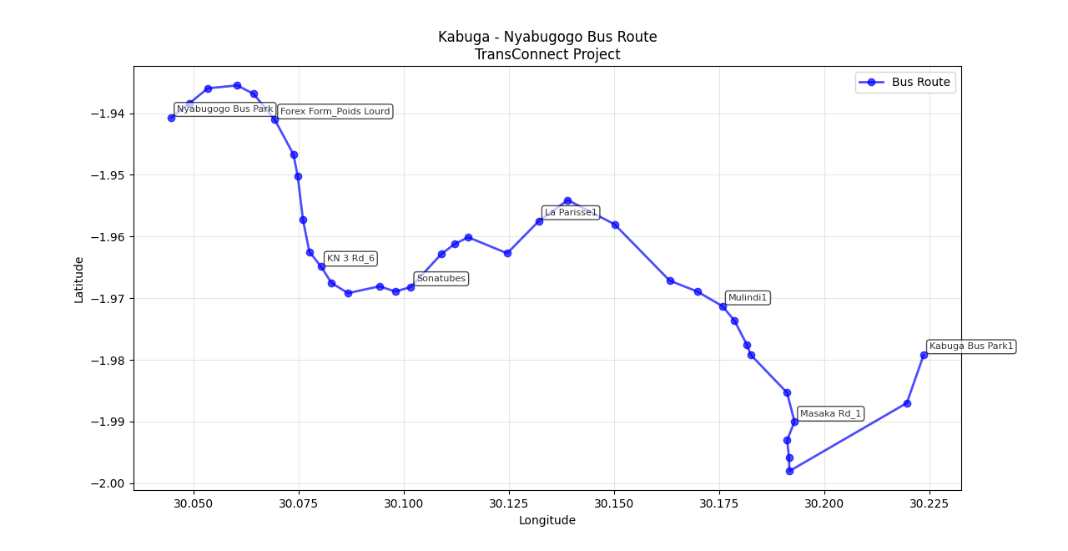


5. VISUALIZATION & IMPACT
Before Preprocessing:
Messy, overlapping points on map
Inconsistent stop representations
Unreliable spatial relationships
After Preprocessing:
Clean, sequential route visualization
Accurate stop positioning
Calculated distances and travel times
Impact on Model Readiness:
Clean spatial data for route optimization
Engineered features for arrival prediction
Structured data for CI algorithms (Genetic Algorithms, ML)
Foundation for real-time intelligence system

Slide 10
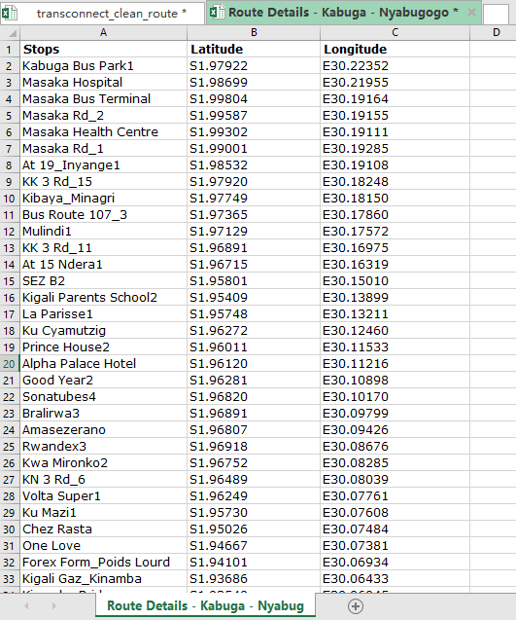
BEFORE – DATA PREPROCESSING

Slide 11
DATA PREPOCESSING STEPS

Slide 12
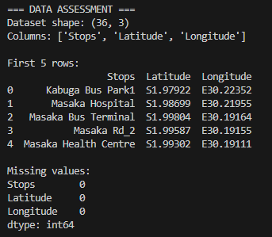
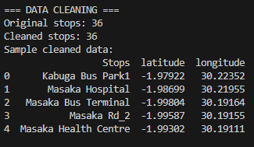

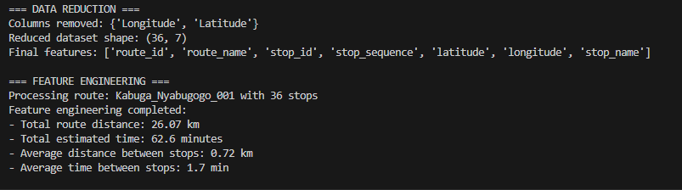
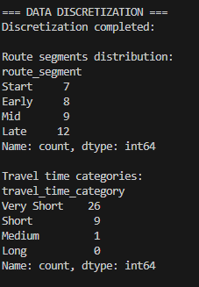
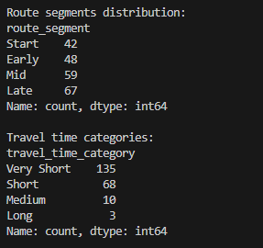

Slide 13
VISUALIZATION

Slide 14
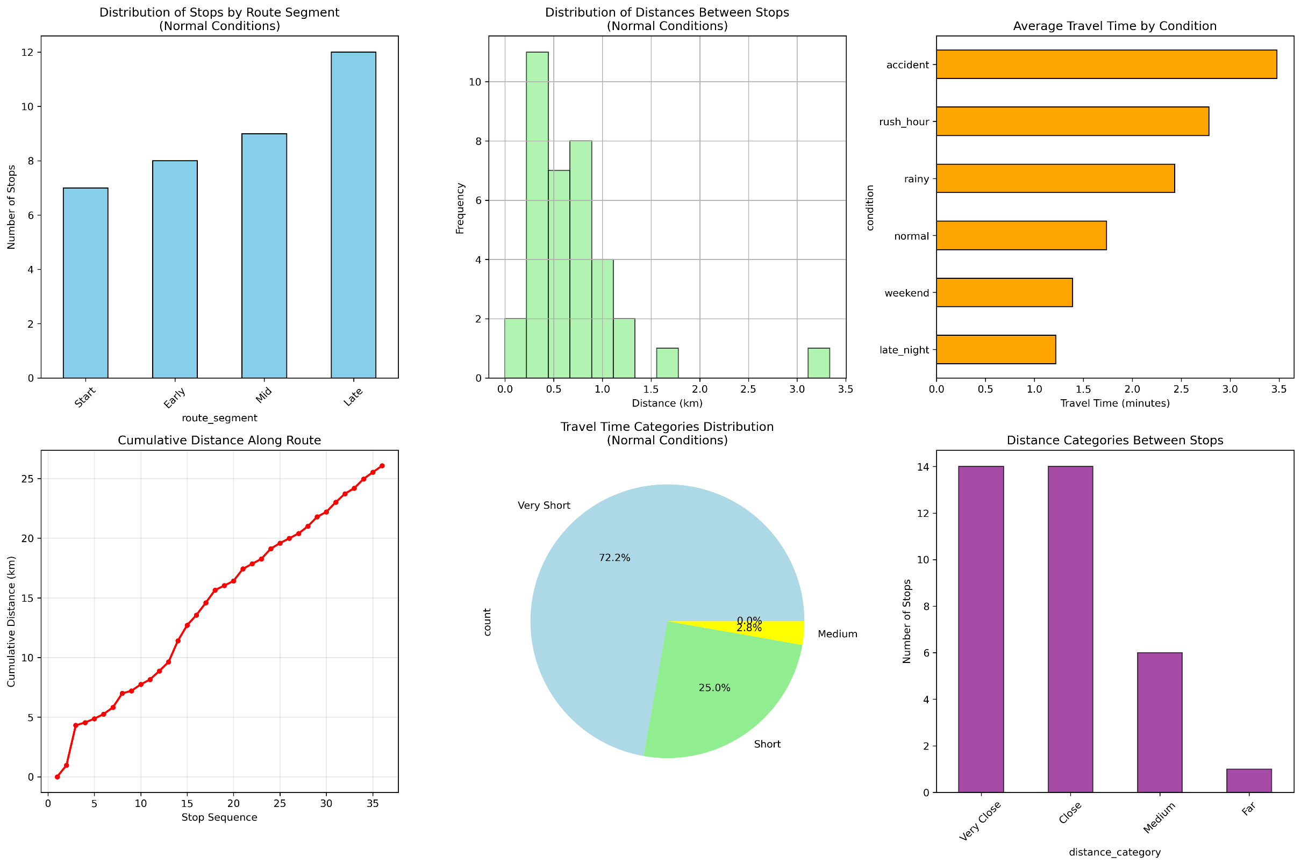

Slide 15
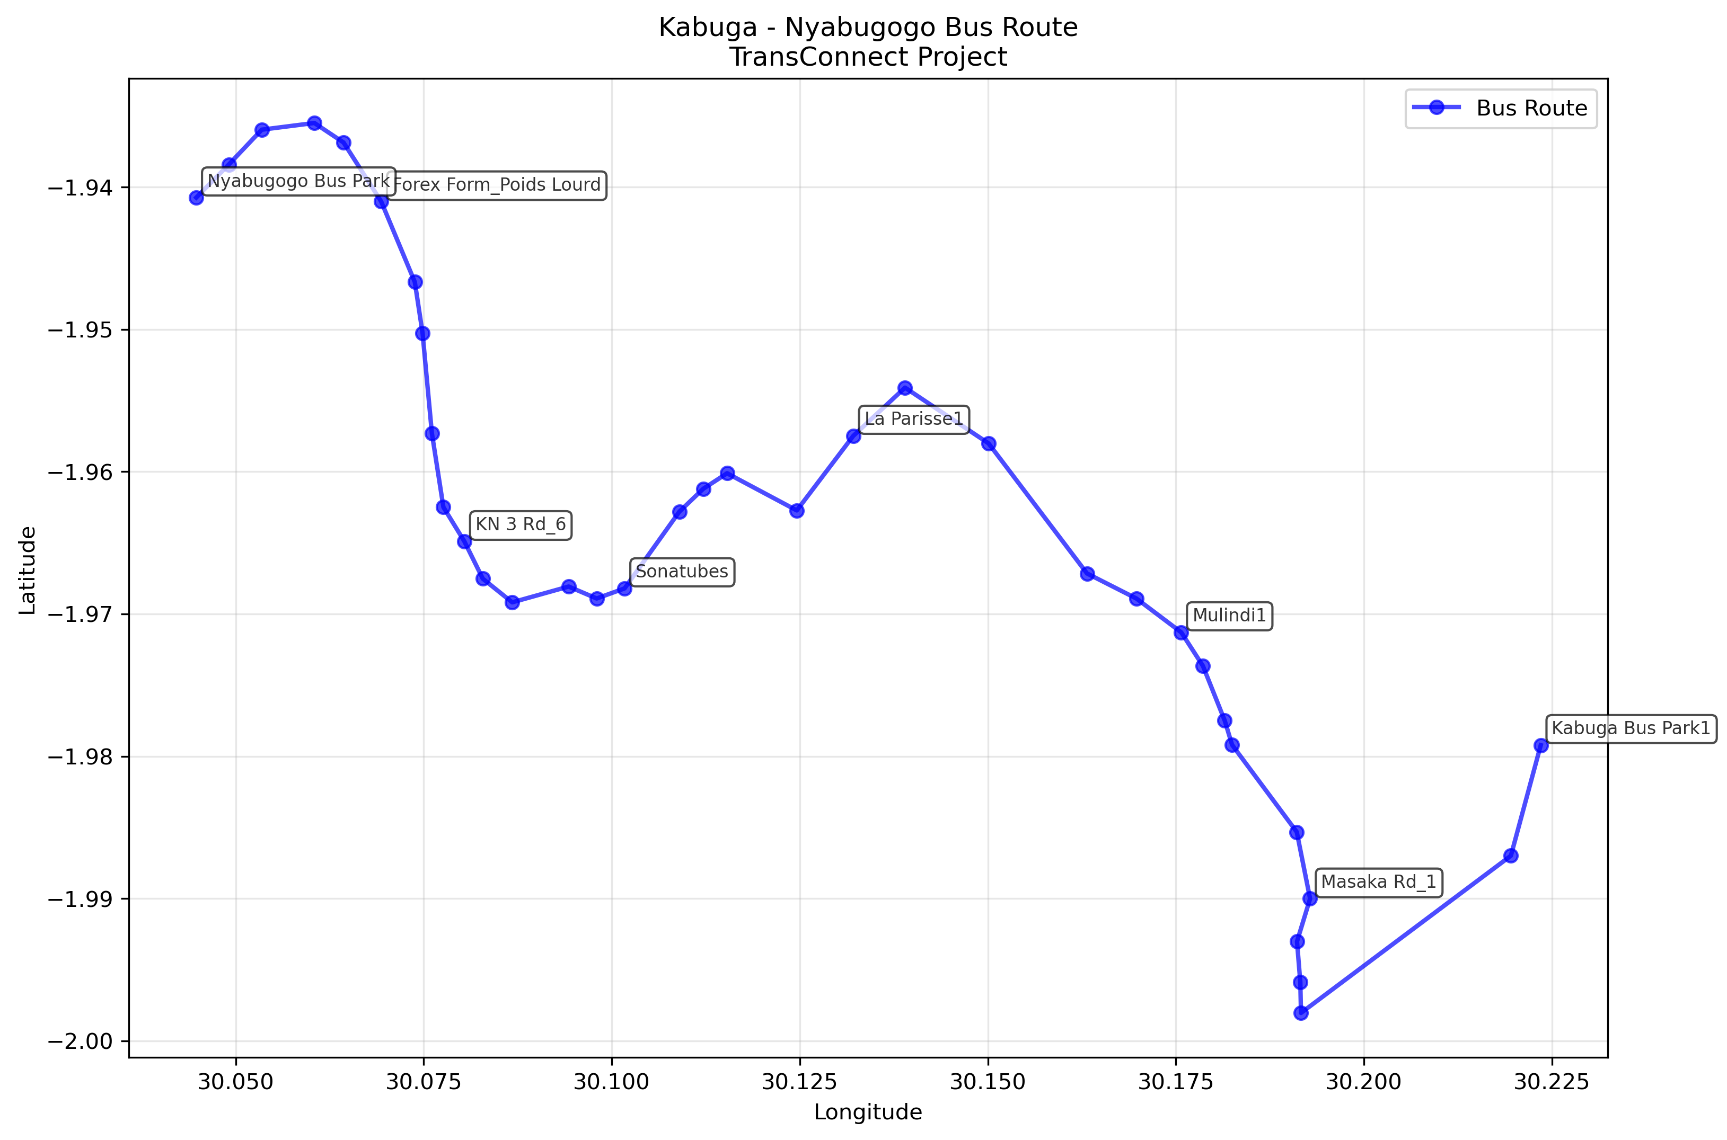

Slide 16
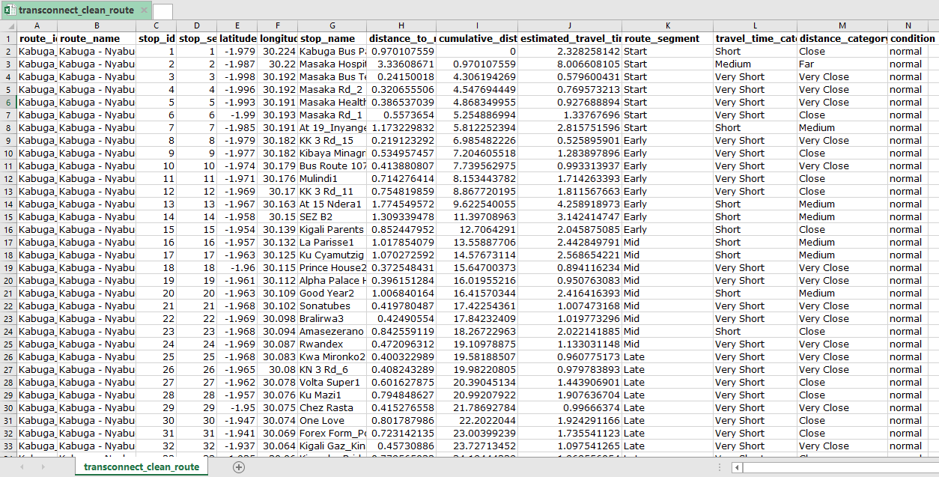
AFTER – CLEAN PREPROCESSING

Slide 17

CHALLENGES & LESSONS LEARNED
Conclusion: The preprocessed dataset is now ready for:
Machine learning model training, Route optimization algorithms, Real-time arrival prediction systems, Intelligent transportation analytics.
Challenges Encountered:
Interpreting mixed coordinate formats.
Standardizing stop names without official references.
Handling incomplete route information.
Ensuring spatial accuracy for distance calculations
TRANSCONNECT DATA PREPROCESSING SUMMARY
==================================================
Original stops: 36
Cleaned stops: 36
Total route distance: 26.07 km
Total travel time: 62.6 minutes
Augmented dataset size: 216 rows
Conditions simulated: 6
Lessons Learned:
Data preprocessing is crucial (80% of data science work)
Clean, structured data enables effective CI applications
Domain knowledge essential for data interpretation
Quality preprocessing directly impacts model performance
Summary for Transconnect for Route “Kabuga – Nyabugogo”

Slide 18

CODE DEMONSTRATION STRUCTURE
Python Script Sections:
Tools & Libraries:
Pandas for data manipulation
NumPy for numerical operations
Scikit-learn for preprocessing
Haversine for distance calculations
Matplotlib/Plotly for visualization
Folium for map-based displays
Data Loading & Initial Assessment
Data Cleaning Operations
Data Integration & Deduplication
Feature Engineering (Distance Calculations)
Data Transformation & Discretization
Codes: https://drive.google.com/file/d/120uvRQOfj2I6KP-9buP23hwFub0JSyPO/view?usp=sharing
Dataset: https://docs.google.com/spreadsheets/d/1nQSVadk_r9I_5k6FVnBV3_UW04ITMIJ-7orBFDDlBv8/edit?usp=sharing
Data Augmentation for Model Training
Visualization of Results

Slide 19
END

